Slide 1
HackED 2025
Raspberry Pi Pico with Rust
Steven Knudsen, PhD PEng
knud@ualberta.ca

Slide 2

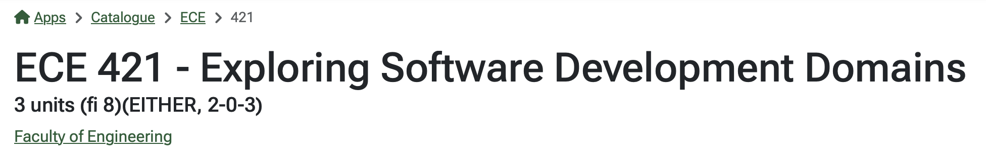

Slide 3
Outline
Raspberry Pi Pico and Pico W overview
Why Rust?
Setting up for Rust development
Setting up Rust on a Pico
Simple Program
More complicate Program
Wokwi.com and Pico

Slide 4
Sources for the talk
github.com/StevenKnudsen/HackED2025Workshop

Slide 5
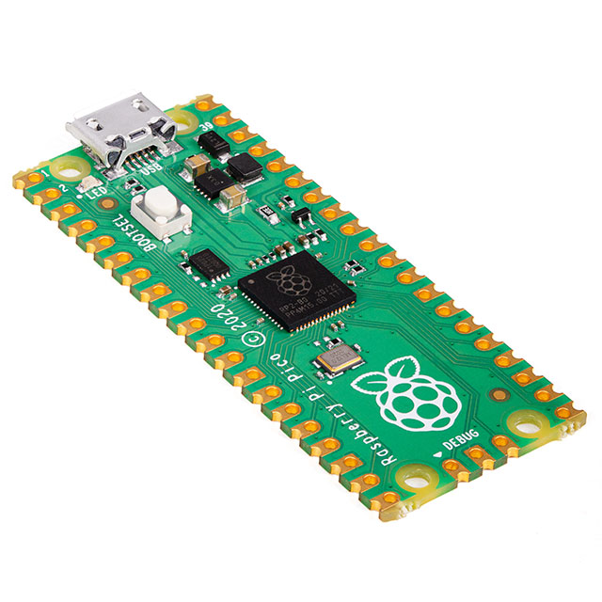
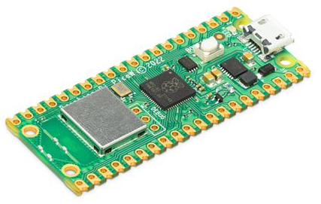
Raspberry Pi Pico and Pico W
Raspberry Pi Pico is a low-cost, high-performance microcontroller board with flexible digital interfaces. Key features include:
RP2040 microcontroller chip designed by Raspberry Pi in the United Kingdom
Dual-core Arm Cortex M0+ processor, flexible clock running up to 133 MHz
264 kB of SRAM, and 2MB of on-board flash memory
USB 1.1 with device and host support
Low-power sleep and dormant modes
Drag-and-drop programming using mass storage over USB
26 × multi-function GPIO pins
2 × SPI, 2 × I2C, 2 × UART, 3 × 12-bit ADC, 16 × controllable PWM channels
Accurate clock and timer on-chip
Temperature sensor
Accelerated floating-point libraries on-chip
8 × Programmable I/O (PIO) state machines for custom peripheral support
Images from digikey.ca

Slide 6
Raspberry Pi Pico and Pico W
$CA5.80 at Mouser.ca $CA8.34 at canada.newark.com
Images from digikey.ca

Slide 7
Getting started with the Pico - MicroPython
The main reference is a very good tutorial
https://projects.raspberrypi.org/en/projects/getting-started-with-the-pico/0

Slide 8
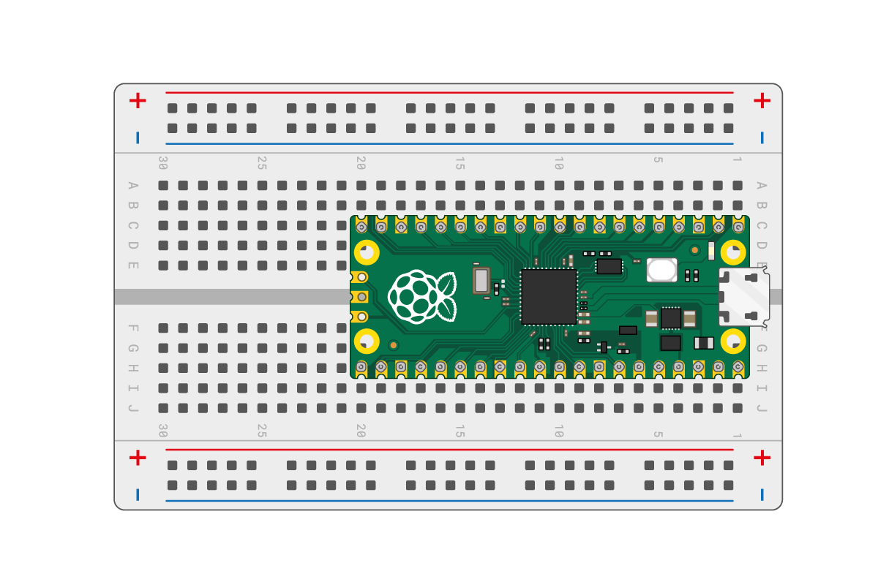
Pico on breadboard
https://projects.raspberrypi.org/en/projects/getting-started-with-the-pico/1

Slide 9
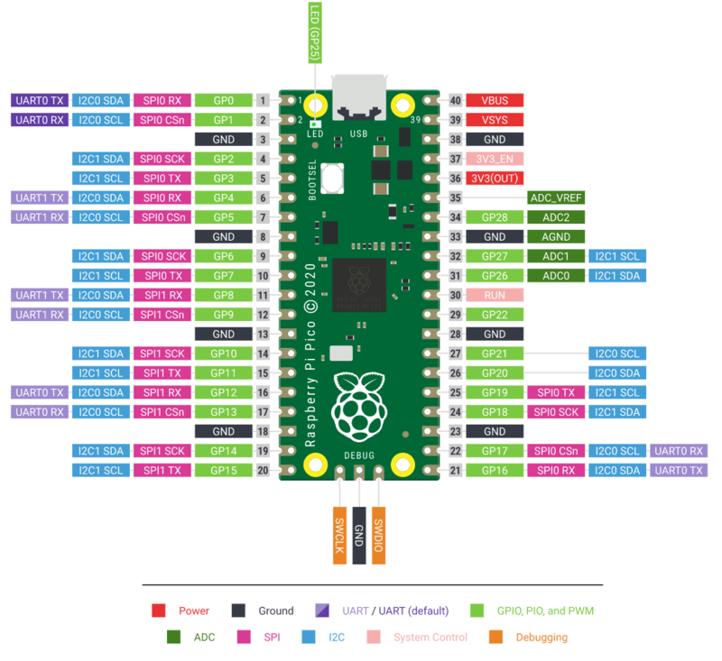
RPi Pico Pins

Slide 10
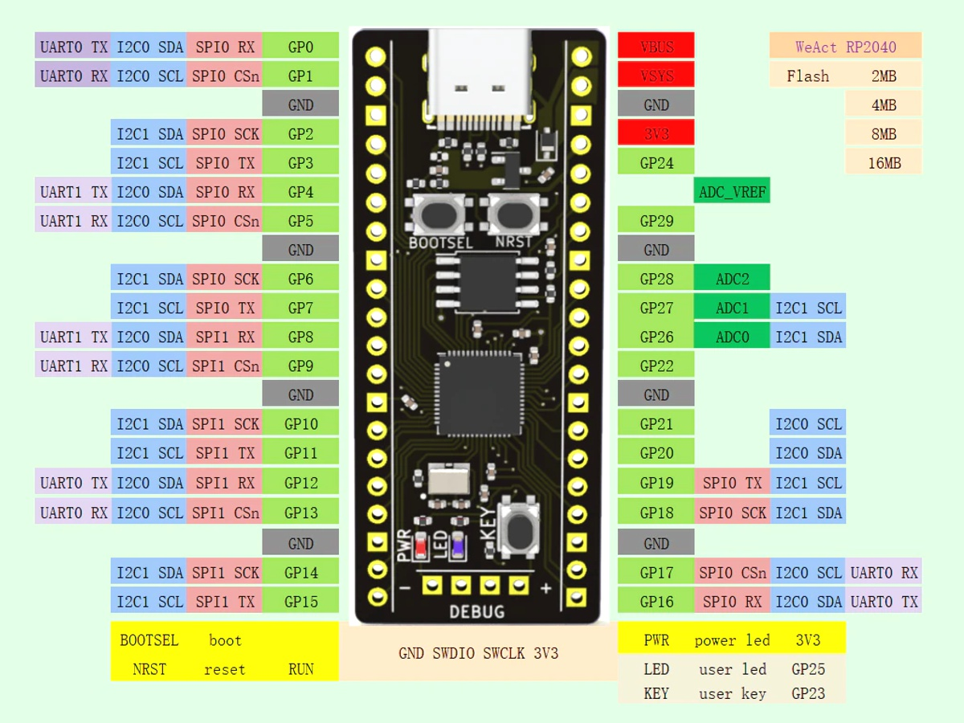
NOT THE SAME!

Slide 11
Assumptions
You know how to program in at least one of the languages
Python or C
Rust, preferably…
You have Pico
You have the official Pico debug tools, or
You have a Segger debug probe, or
A second Pico

Slide 12
Installing Rust
Visit rust-lang.org/tools/install to install rustup
Tool that installs and manages Rust
Rust is developed on a 6-week sprint, good to update often
rustup self update
rustup update stable

Slide 13
rp-rs
Github project that supports a Rust HAL (hardware abstraction layer) that enabled embedded programming in Rust on the Raspberry Pi Pico family
rustup target add thumbv6m-none-eabi
cargo install flip-link
May have dependency issues. Ubuntu 24.04 needed libudev-dev installed, for example

Slide 14
VSCode
Install rust-analyzer, Debugger for probe-rs
Install crates — Keeps crates up to date
Get debugprobe_on_pico.u2f from github.com/raspberrypi/debugprobe/releases
Drag and drop programming with pico in bootloader mode

Slide 15
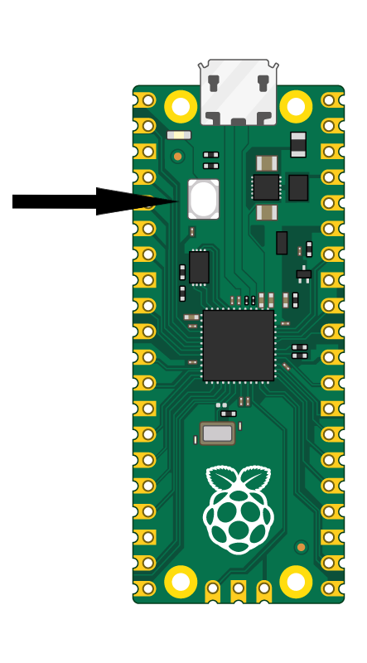
Pico in boot select (bootsel) mode
Unplug Pico from USB
Press and hold bootsel button
Plug Pico into USB and wait a few seconds
Release bootsel button
Pico appears as storage device
Drag and drop u2f image
https://projects.raspberrypi.org/en/projects/getting-started-with-the-pico/3

Slide 16
Probe-rs – gdb effectively
Use probe-rs
Check for pico probe and show output
Could use cargo install --locked probe-rs-tools, but instead
$ curl --proto '=https' --tlsv1.2 -LsSf https://github.com/probe-rs/probe-rs/releases/latest/download/probe-rs-tools-installer.sh | sh
$ probe-rs list
The following debug probes were found:
[0]: Debugprobe on Pico (CMSIS-DAP) – 2e8a:000c:E6616407E33CA42F (CMSIS-DAP)
Be sure to set up udev rules in Linux

Slide 17
Blinky program example
Borrow from Murray Todd on Medium https://murraytodd.medium.com/learning-rust-with-embedded-programming-on-rp2040-e784389d2d3d
Use hardware abstraction layer (HAL) from rp-rs project
https://github.com/rp-rs
Go to rp2040-project-template, clone git clone https://github.com/rp-rs/rp2040-project-template.git

Slide 18
VSCode work
Open the template folder in VSCode
Check in .cargo/config.toml that runner = "probe-rs run --chip RP2040 --protocol swd”
In Cargo.toml rename the project to rp2040-blinky
In .vscode/launch.json change "programBinary": "target/thumbv6m-none-eabi/debug/rp2040-project-template” to "programBinary": "target/thumbv6m-none-eabi/debug/rp2040-blinky"

Slide 19
VSCode work
In .vscode/launch.json, uncomment the line "svdFile": "./.vscode/rp2040.svd"
Manually download rp2040.svd from https://raw.githubusercontent.com/raspberrypi/pico-sdk/1.3.1/src/rp2040/hardware_regs/rp2040.svd and place it in the .vscode directory so that the debugger can find it

Slide 20
VSCode work
In Cargo.toml, uncomment the two lines with rp2040* # If you're not going to use a Board Support Package you'll need these: rp2040-hal = { version="0.10", features=["rt", "critical-section-impl"] } rp2040-boot2 = "0.3” so that the HAL is included
Time to run the debugger!

Slide 21
One more tool – Wokwi.com

Slide 22
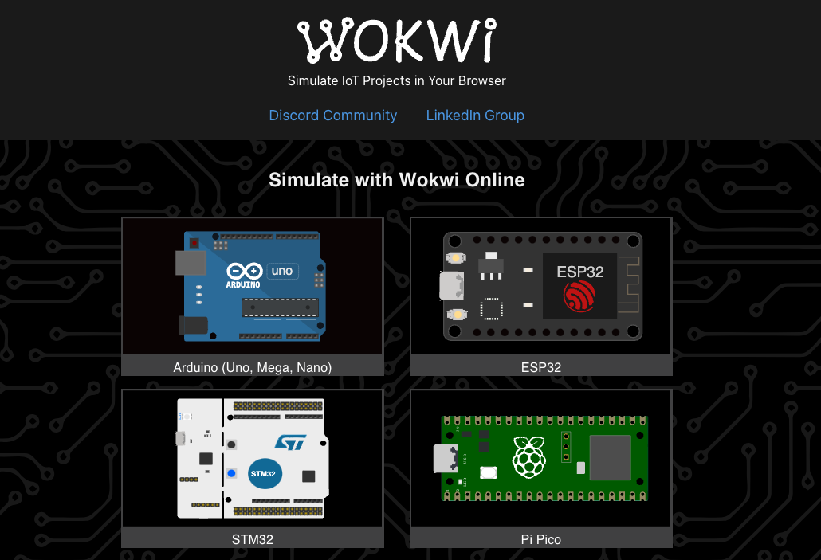

Slide 23
What is Wokwi.com? (from docs.wokwi.com)
Wokwi is an online Electronics simulator. You can use it to simulate Arduino, ESP32, STM32, and many other popular boards, parts and sensors.
Here are some quick examples of things you can make with Wokwi:
Arduino Uno "Hello World"
Blink an LED on ESP32
Monitor the weather on ATtiny85
Control 32 Servos with Arduino Mega
Animate an LED Matrix with FastLED
7 Segment Counter with MicroPython on ESP32
…and Pico!

Slide 24
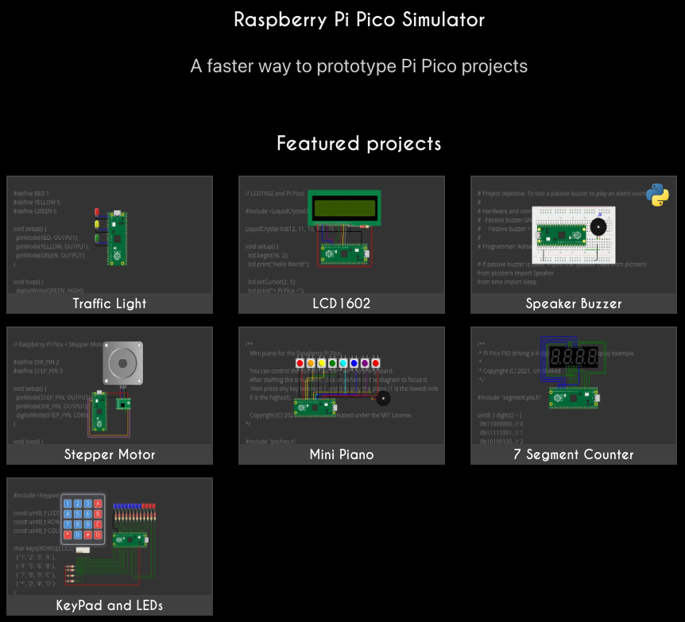

Slide 25
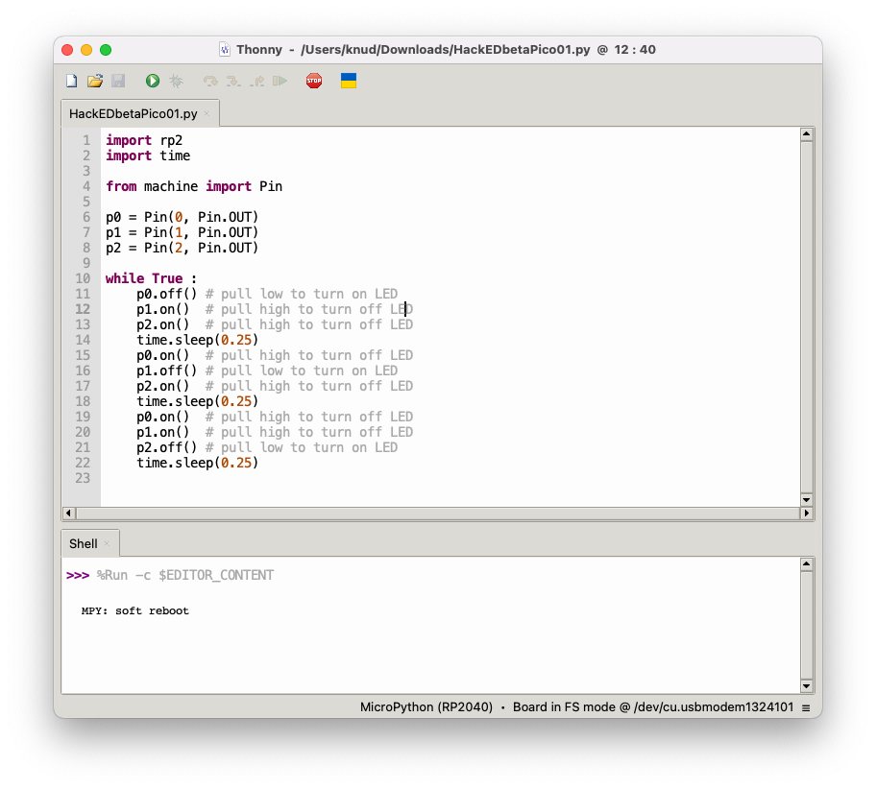
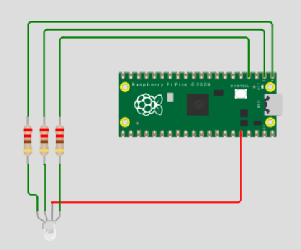
Simple RGB blinky

Slide 26
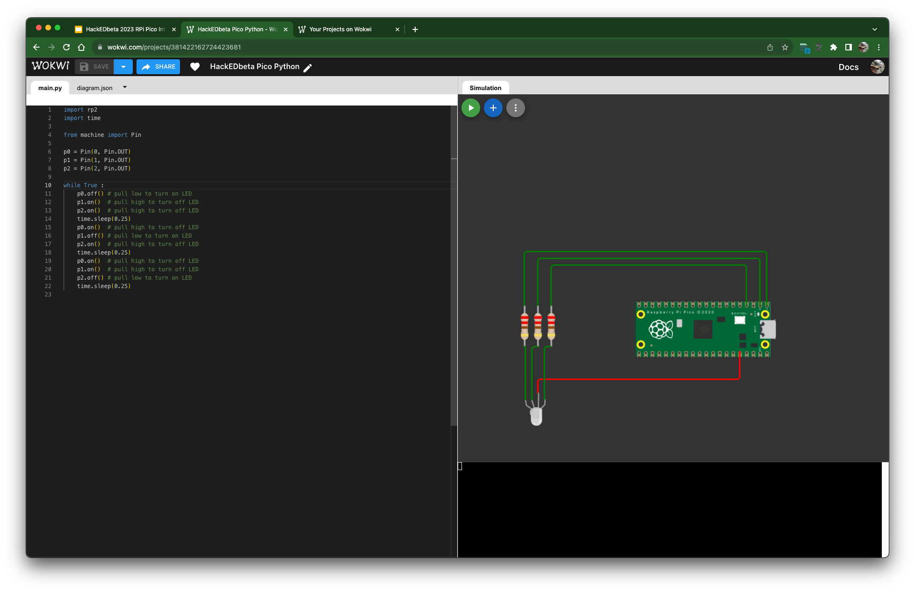
Wokwi Version

Slide 27
Trivia
...with wee prizes...

Slide 28
Trivia
Who created the first artificial neural network and when?

Slide 29
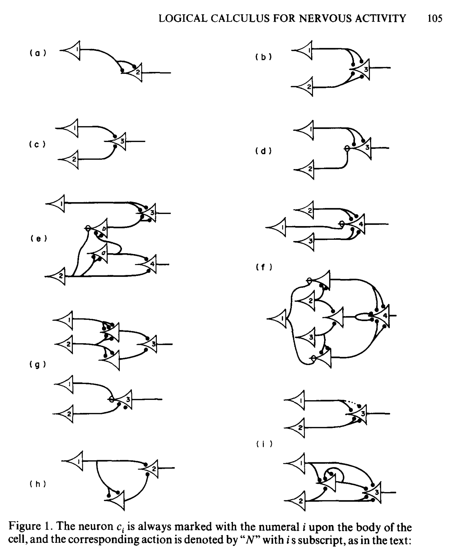
Warren McCulloch and Walter Pitts
1943
Perceptron
Modelled using electrical circuits
Notes:
Prize 1 chosen

Slide 30
Trivia
What is an equivalent to the U of A’s main frame computer from the 80s?

Slide 31
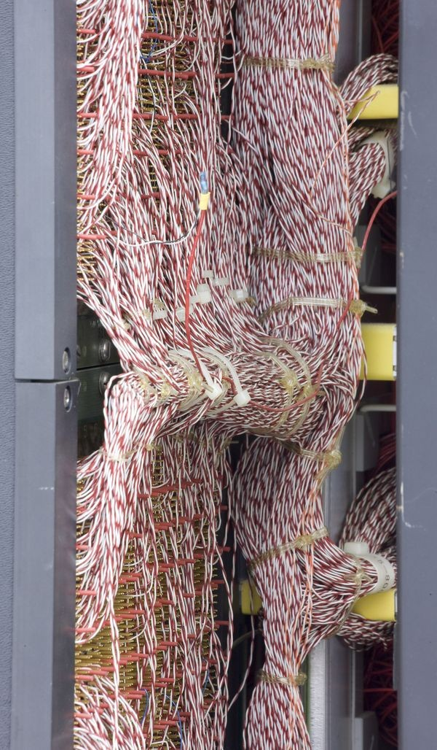
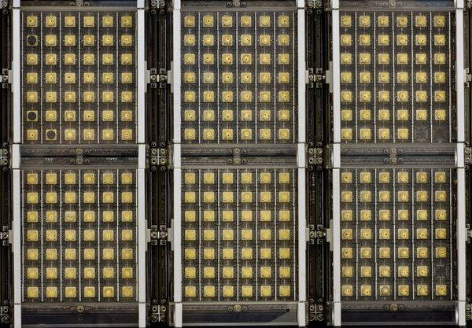
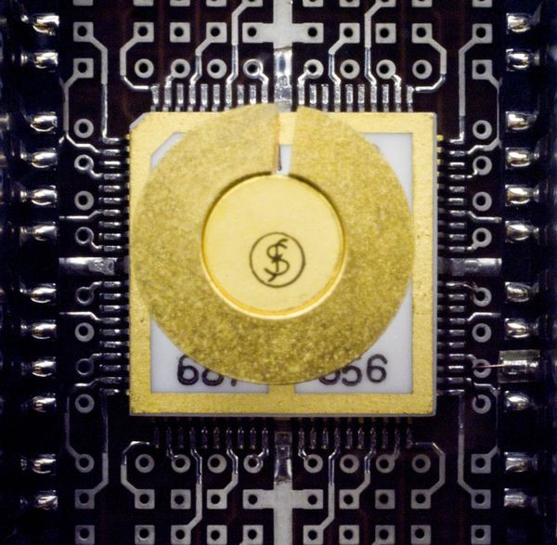
Amdahl 470 v/6
Date Introduced : 1975
Dimensions overall: 63” x 70” x 26”
Keywords : Clones; Plug compat; IBM
Speed : 3.5 MIPS
Memory Size : up to 8MB
Memory Width : 32-bit
Cost : $3,750,000 (2020 $17,981,250)

Slide 32
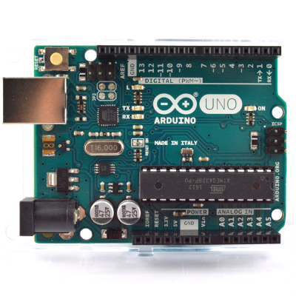
Arduino
Date Introduced : 2010
Dimensions overall: 2.7” x 2.1” x 0.6”
Speed : 8 - 11 MIPS
Memory Size : 32k FLASH 2k SRAM
Cost : ~$20
Cost to make : < $5

Slide 33
Trivia
What are the most loved and hated languages in the 2022 Dice survey
Notes:
https://www.dice.com/career-advice/20-programming-languages-that-developers-love-the-most

Slide 34
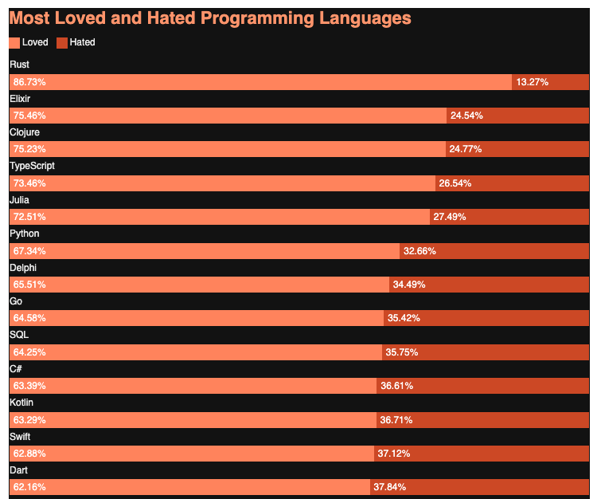
Most loved
Rust 86.83%
Elixir 75.46%
Clojure 75.23%
TypeScript 73.46%
Julia 72.51%
Python 67.34%

Slide 35
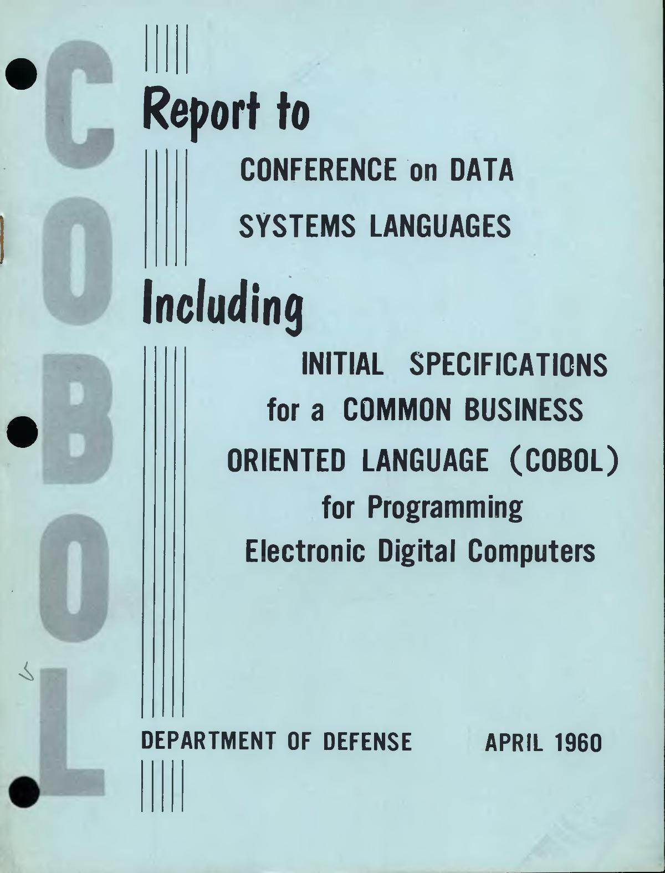
Most hated
VBA (78.56 percent).
COBOL (hated by 79.96 percent of developers)
MATLAB (80.84 percent), and

Slide 36
Most hated
VBA (78.56 percent).
COBOL (hated by 79.96 percent of developers)
MATLAB (80.84 percent), and

Slide 37
